Slide 1

EngageCARE
Connecting CHF Patients with Caregivers

Slide 2






Friends & Family Caregivers
Caregiver
Doctor
Dad

Slide 4
Hard to get patient/care giver to enter all info

Slide 6
Swelling, shortness of breath, sleeplessness (number of times waking up from trouble breaking), palpations/fast heart beat

Slide 8
Hard to track, lots of trackers, cardiologoist no good answer

Slide 10
Baseline – changes relative to baseline.. Like walking to mailbox

Slide 12
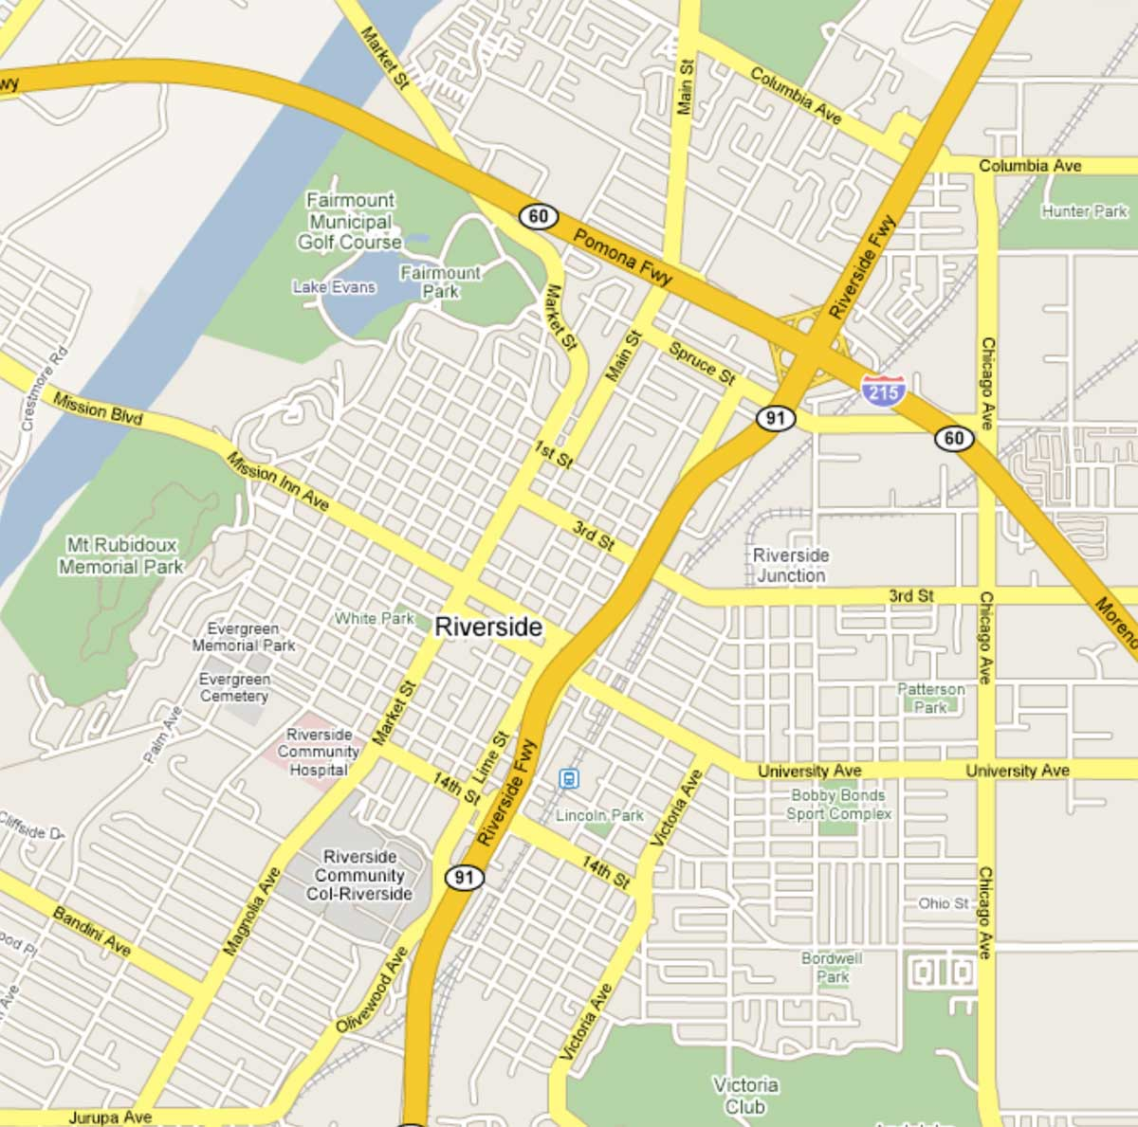
Check In
Back
Client:
Joan Senior (415-555-2359)
Notes:
Today at 3pm. Clean all house gutters for winter rains, will need ten foot ladder....
Address
San Francisco, CA
Directions Search Nearby Save More
Start Task

Slide 14
Rewards – carrot
Need carrot and STICK (the seriousness of CHF is death.)

Slide 15
CHFCare
Plan
Behavioral
Support
Remote Monitoring Devices Caregiver Reporting Self Reporting
Reporting
Layer
SMS/Mobile/Website/ IVR

Slide 16
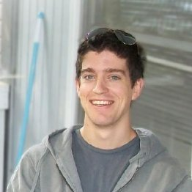
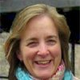
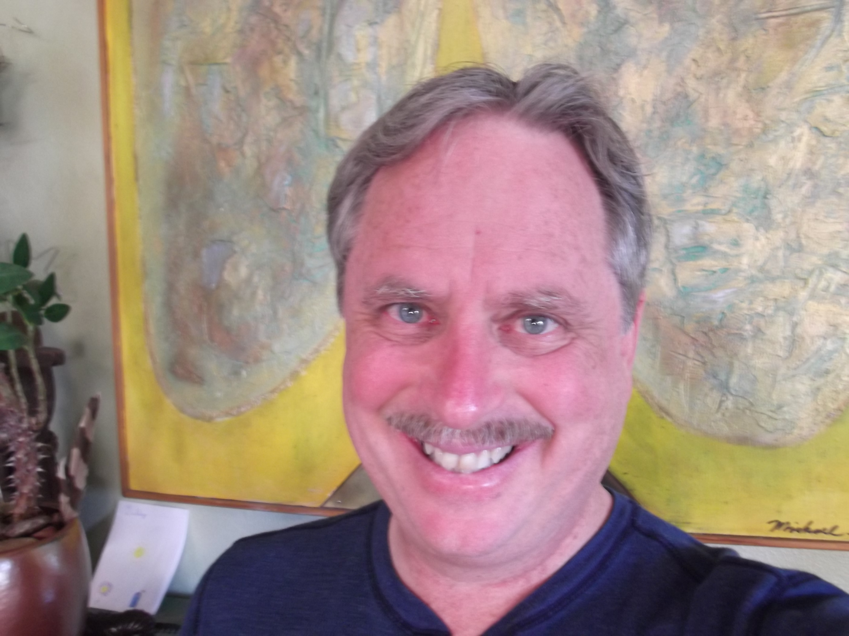
EngageCARE Team
Evin Ollinger – CEO. Fourth startup, two successful exits. 30 years in high-tech and online services in B2B and B2C markets. Led marketing at ATT Language Line Services serving 84% of US Hospitals, 8 of top 10 Insurance Companies and US Government CMS, HHS and CDC.
Brent Daugherty – CTO, M.S. CS, EE Lead Mobile Web Application Developer at Eveo, #1 Healthcare digital agency. Clients include Johnson & Johnson, Merck, Pfizer, Bristol-Myers Squibb and Roche.
Mary Stanton – VP Care, MSW, LCSW. Senior Web Architect HealthCommunities.com, 28 websites and 3,000 doctors. Case manager at VNA for in-home chronic and senior care clients.

